Slide 1
Acid Rain

Slide 2
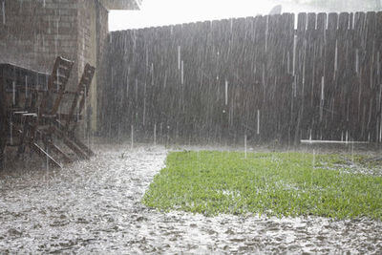
Rain is naturally acidic, with a pH between 5 and 6.
This is because carbon dioxide dissolves into rainwater and then reacts with it in the reaction below:
water + carbon dioxide → carbonic acid
The presence of carbonic acid in rainwater makes the rainwater acidic. Carbonic acid is a weak acid, and is found in low concentrations in rain. This makes the pH quite high for an acid.

Slide 3



Slide 4
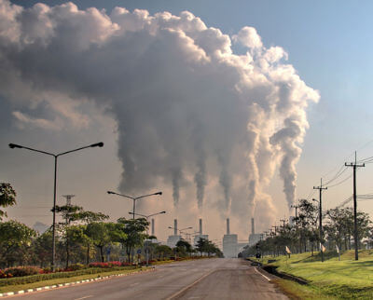
Over the last few centuries the burning of fossil fuels such as coal and oil has increased constantly.
Burning these fuels releases many different gases into the atmosphere.
This has not only increased the amount of carbon dioxide, but has also increased the amount of other dioxides such as sulfur dioxide and nitrogen dioxide.
All of these gases dissolve in water to make acids.

Slide 5

The reaction of various dioxides with rainwater creates sulfuric and nitric acid alongside the carbonic acid.
Nitric and sulfuric acids are strong acids, and so the pH of this rainwater, which we call acid rain, can get down as low as pH 3.3.

Slide 6
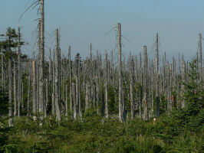
The acidity of rain is normally neutralised by basic chemicals in the environment, such as limestone.
However, when rain becomes too acidic the environment cannot neutralise all the acid.
Acid rain can result in damage to crops, trees, lakes, rivers and animals. Statues and buildings can also be eroded by acid rain.

Slide 7


